Slide 1
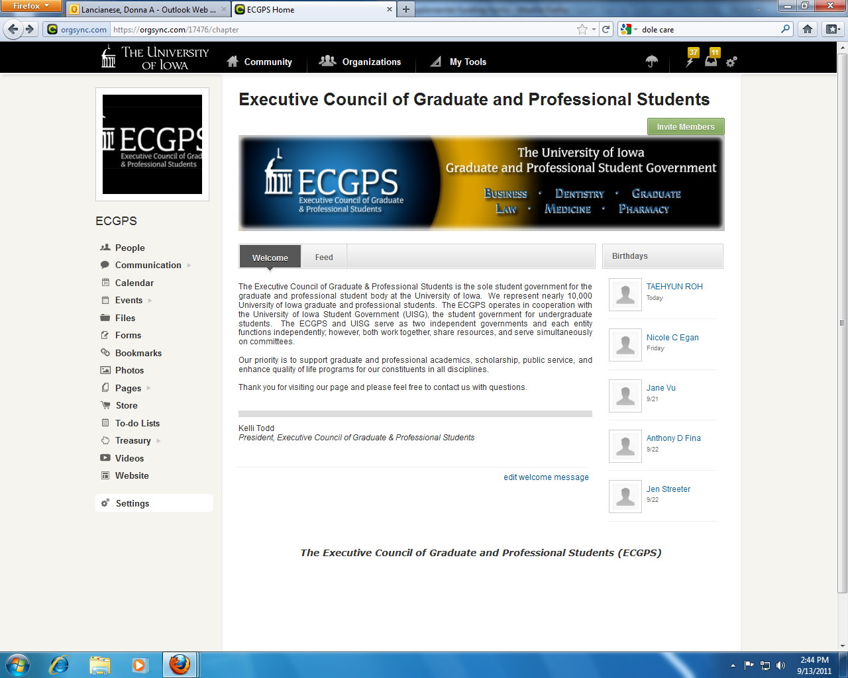
Log into OrgSunc and go to your org’s main page….

Slide 2

Hover over Treasury and click on Budgets

Slide 3
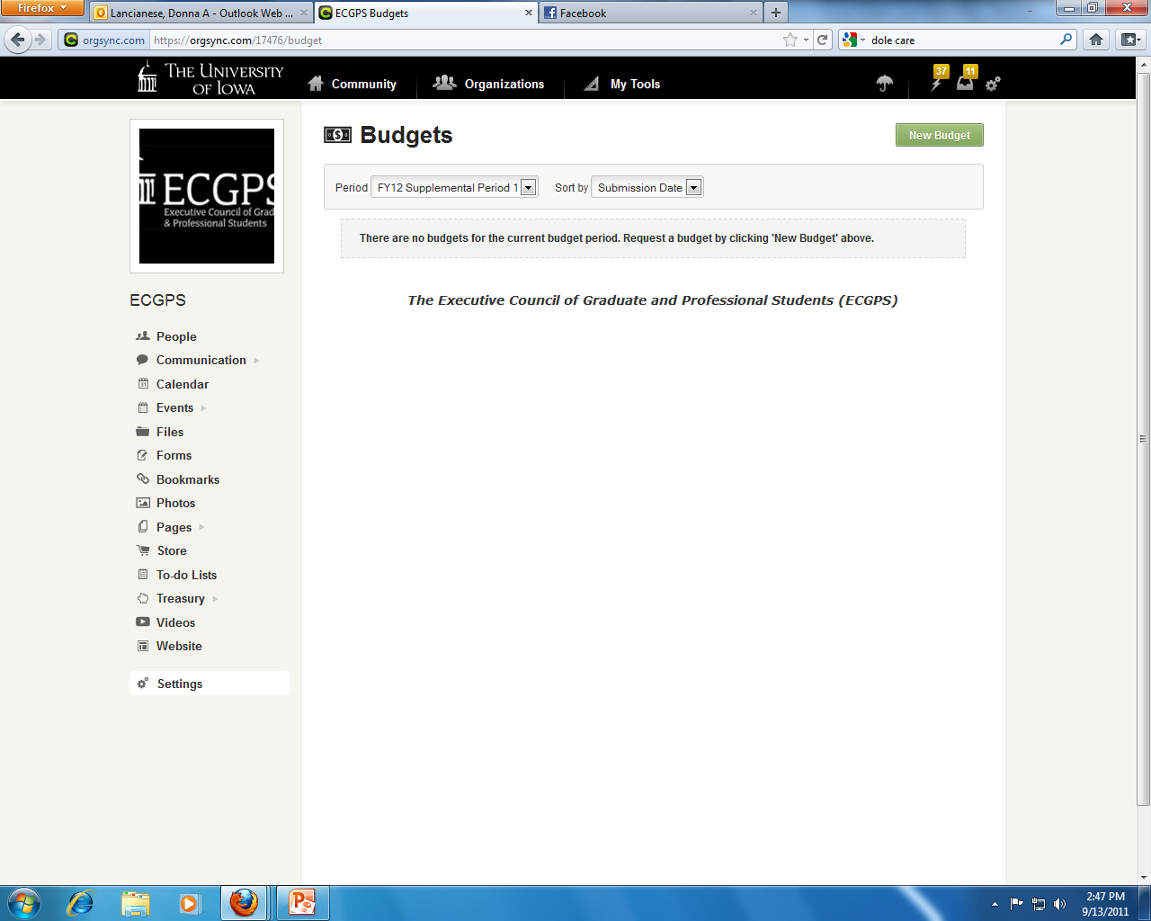
Make sure you have the correct period (red circle) and then click on new budget (yellow circle)

Slide 4
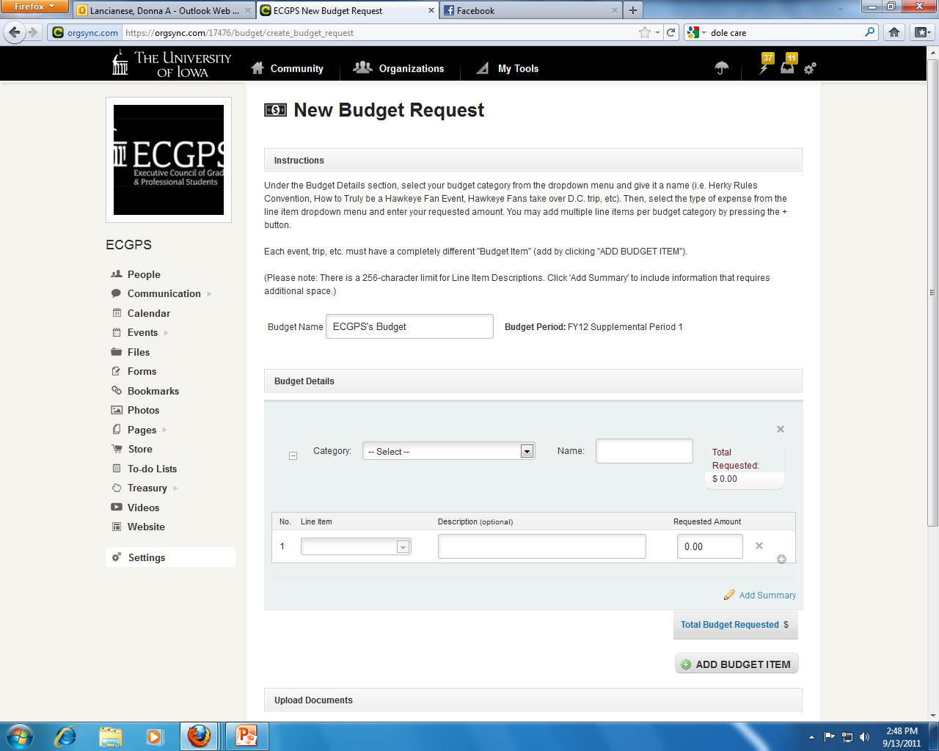
Fill out the request

